Slide 1
CSE445/465 Final Report
24/04/2026

Slide 2

Final Report
IEEE Journal/Conference Single Column Format
IEEE LaTeX format MUST
Minimum 6 pages in length

Slide 3
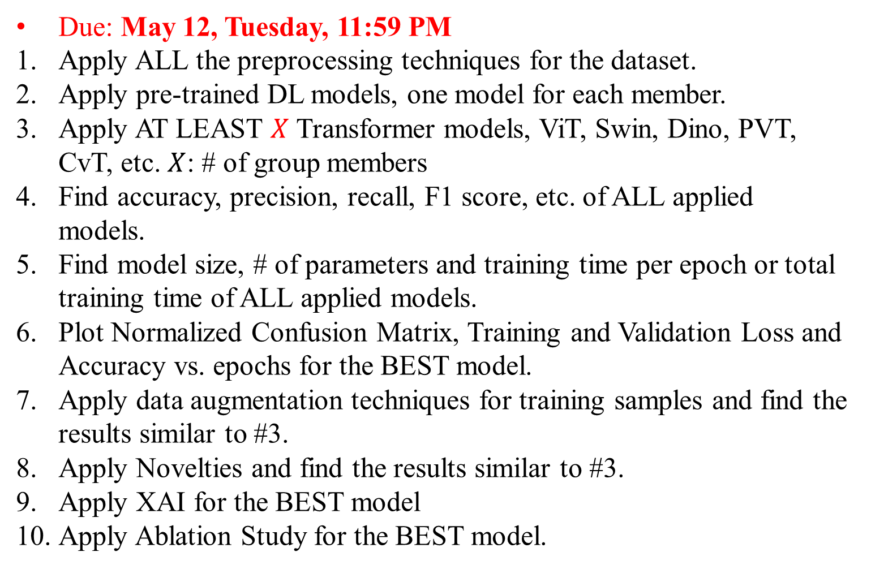
CSE465 Final Report
Due: May 12, Tuesday, 11:59 PM
Apply ALL the preprocessing techniques for the dataset.
Apply pre-trained DL models, one model for each member.
Apply AT LEAST $X$ Transformer models, ViT, Swin, Dino, PVT, CvT, etc. $X$: # of group members
Find accuracy, precision, recall, F1 score, etc. of ALL applied models.
Find model size, # of parameters and training time per epoch or total training time of ALL applied models.
Plot Normalized Confusion Matrix, Training and Validation Loss and Accuracy vs. epochs for the BEST model.
Apply data augmentation techniques for training samples and find the results similar to #3.
Apply Novelties and find the results similar to #3.
Apply XAI for the BEST model
Apply Ablation Study for the BEST model.

Slide 4
LaTeX
Use Overleaf: MUST
Use IEEE single-column format: \documentclass[journal,onecolumn]{IEEEtran}
Cite Tables and Figures automatically with \label{} and \ref{}
Use \begin{equation} and \end{equation} for all the equations
Use .bibtex for the References
Use \bibliographystyle{IEEEtran} for citing the references
Submit LaTeX link with edit access in Canvas
LaTeX Error: Not Allowed. Warning: Allowed

Slide 5
CSE445/465 Final Report
Abstract
Keywords
Introduction
Proposed System
4.1: Dataset
4.2: Dataset Preprocessing
4.3: Applied Models
5. Results and Discussion
5.1: Ablation Study
6. Conclusions
References

Slide 6
Abstract
All papers must include an abstract and a set of index terms
Main work of the paper in a concise paragraph
Approximately 200 - 300 words long
Write about dataset, preprocessing, applied models, results, ablation study, XAI, etc.
Do not cite references or use abbreviations, symbols, equations in the abstract
Abstract will be copied and included in the conference proceedings or journal’s webpage
Keywords – main topics in alphabetical order

Slide 7
Abstract
Concise summary with an overview of the study's key elements
Common lengths range from 200 to 300 words.
Research Purpose or Objective: Begin by stating the primary goal or purpose of the research. What problem or question does the study aim to address?
Methodology: Provide a brief description of the research methods and techniques used to conduct the study. Mention the research design, data collection methods, and any key tools or instruments used.
Results: Summarize the main findings or outcomes of the research. Highlight the most important data, statistics, or trends that were discovered during the study.
Conclusion: Present the conclusions or implications of the research. What are the key takeaways from the study, and how do they relate to the research objective?

Slide 8
Introduction
First paragraph: motivation of your capstone project or why you have chosen the specific project
Each group member has to review at least one journal (recommended) or conference paper individually.
Introduction - Already works done on this topic with proper references, e.g., [1], [2]
End of Literature Review: Discuss the existing gaps, limitations and weaknesses of the related works
Brief description of YOUR WORK in 3-4 paragraphs: Second-last paragraph
Last paragraph – describes different sections of the paper

Slide 9
Proposed System
Describe your project briefly here with details on dataset, preprocessing steps, applied models, flowcharts, tables and figures
Add citation of the used dataset
Include the equations
Add figure and algorithm Custom model/algorithms
Include Flowchart of your complete system
Do not show any results in this section

Slide 10
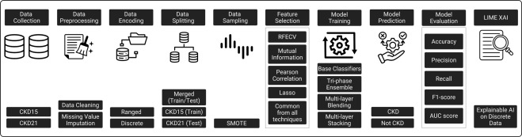
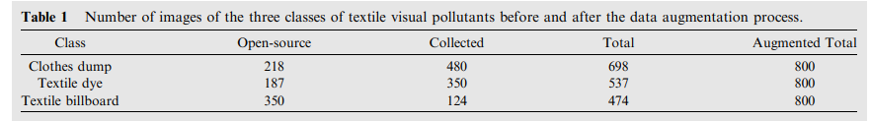
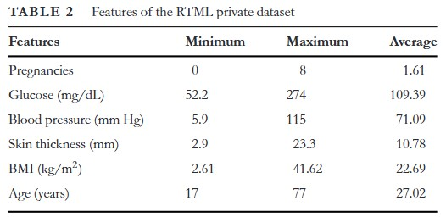
Proposed System

Slide 11
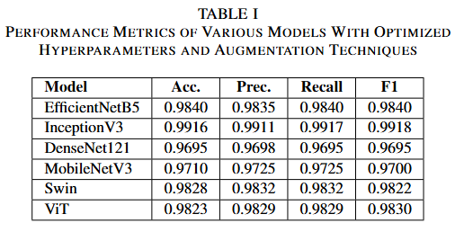
Results and Discussion
Most critical section of research paper
Include all the results in this section
Add performance results (Accuracy, precision, recall, F1 score, IoU, mAP, etc.)
Add model results (# of parameters, model size, training time/epoch)
Add XAI interpretation
LIME, SHAP, GradCAM, etc.
Add comparison table
Discuss the results too

Slide 12
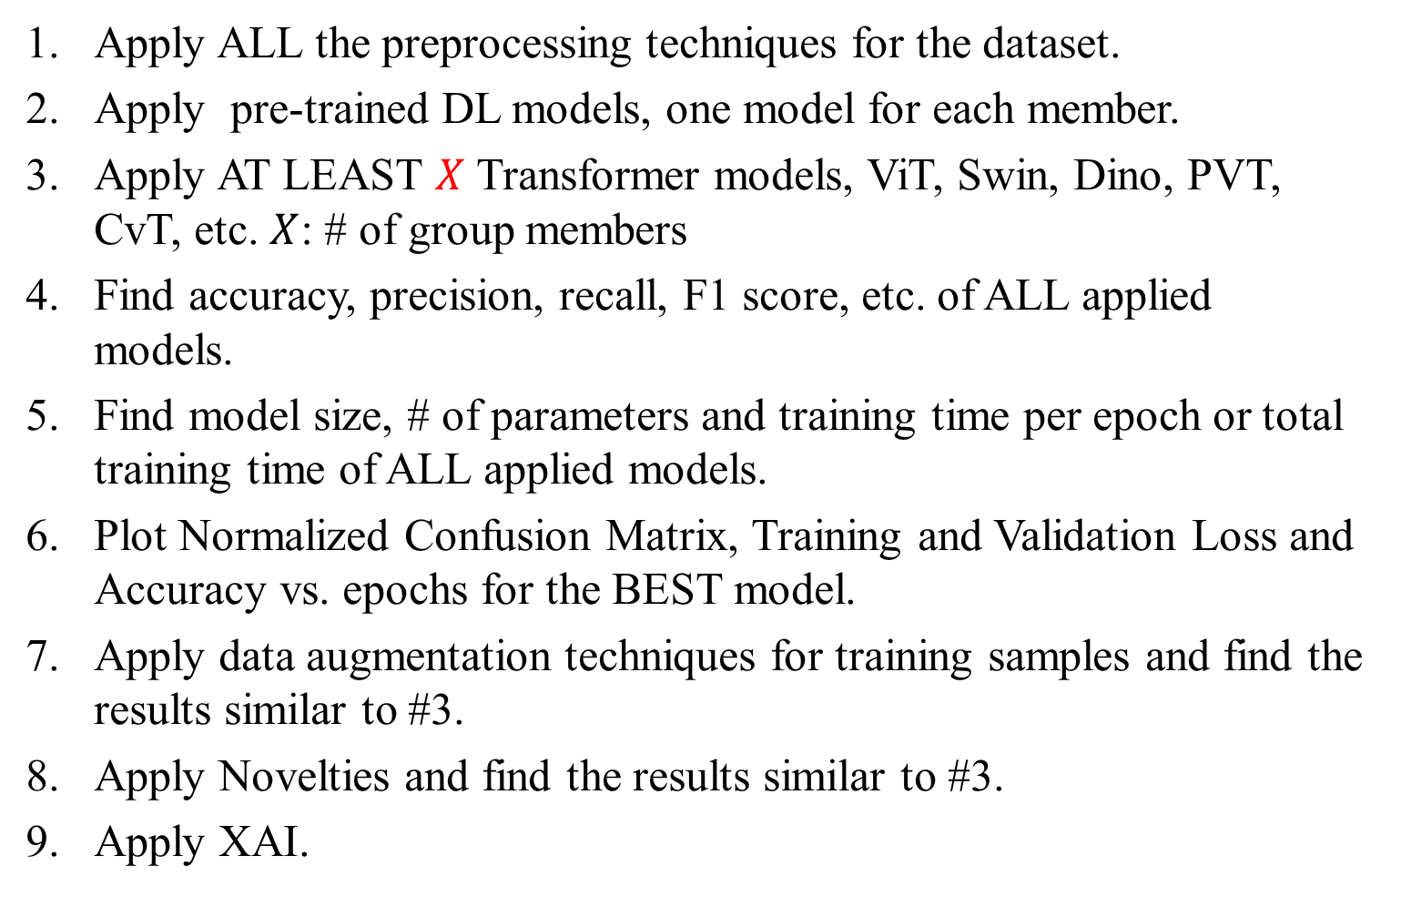
Results and Discussion
Apply ALL the preprocessing techniques for the dataset.
Apply pre-trained DL models, one model for each member.
Apply AT LEAST $X$ Transformer models, ViT, Swin, Dino, PVT, CvT, etc. $X$: # of group members
Find accuracy, precision, recall, F1 score, etc. of ALL applied models.
Find model size, # of parameters and training time per epoch or total training time of ALL applied models.
Plot Normalized Confusion Matrix, Training and Validation Loss and Accuracy vs. epochs for the BEST model.
Apply data augmentation techniques for training samples and find the results similar to #3.
Apply Novelties and find the results similar to #3.
Apply XAI.

Slide 13
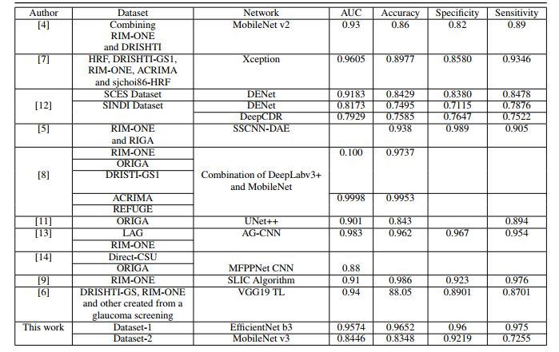
Performance comparison
Performance comparison of the proposed system with other existing works
Required both for software and hardware projects
At the end of the Results and Discussion section

Slide 14
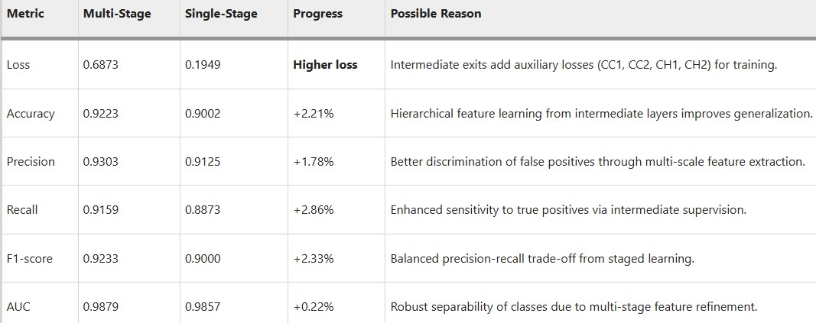
Ablation Study

Slide 15
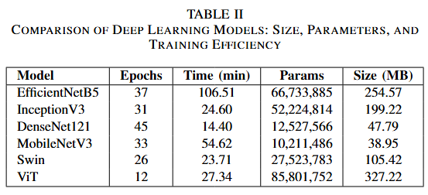
TRAINING TIME RESULTS
Important for ML/DL related works
Mention where the training has been performed

Slide 16
Conclusions
This is the final section of your CSE445/465 report.
In this section, you can write two or three future works.

